Slide 1
Listening Session
Consolidated Plan & Fair Housing Plan
2025-2029

Slide 2
Why are we here today?
The feedback from conversations with our community partners about housing in Maine will help inform two important initiatives:
2025–2029 Consolidated Plan for Housing and Community Development, which directs the uses of federal funding
Fair Housing Analysis, which identifies obstacles and impediments to equal access to housing opportunity

Slide 3
Maine’s Housing Stock
Maine has a rapidly aging housing stock, 34.1% of which is at least 65 years old, and it remains primarily composed of single-family homes.

Slide 4
Housing Availability and Affordability
The income needed to support the median home price is at least 20% greater than the median income in every county in Maine.
Notes:
Housing availability has decreased in Maine, causing home prices and rents to increase

Slide 5
Maine’s Population Trend
Notes:
Until 2019, Maine’s population remained very stable (around 1.33 million).
The population has grown relatively fast, but unevenly, since then.

Slide 6
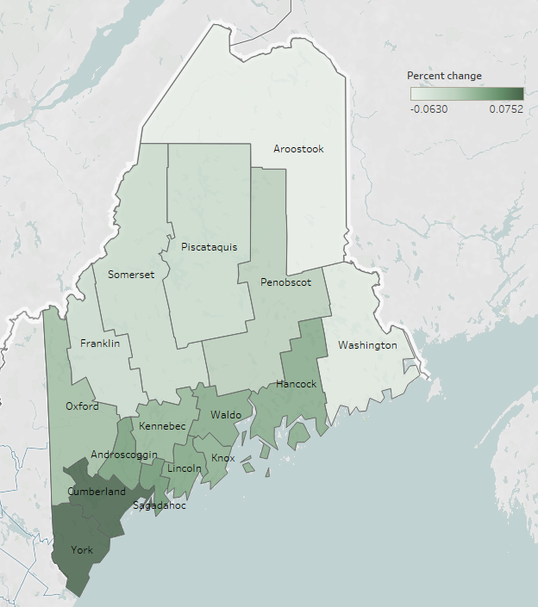
County population change
Whereas the state population increased by 2.8%, some rural counties decreased by as much as 6.3% and southern counties increased by as much as 7.5%.

Slide 7
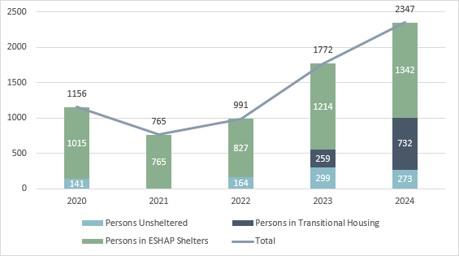
Homelessness in Maine – 2024 Point in Time
People in ESHAP Shelters, Transitional Housing, and Unsheltered

Slide 8
Consolidated Plan
What is the Consolidated Plan?
A 5-year planning document required by HUD to help each state …
Identify affordable housing and community development needs and market conditions;
Establish specific goals
related to the needs and conditions; and
  Develop priorities based on the needs and conditions.

Slide 9
What is the purpose of the Consolidated Plan?
To increase:
Supply of Affordable Housing
Homeownership opportunity
Housing Rehabilitation
Housing and services to those experiencing or at risk of homelessness
Public services to low-and moderate- income households and persons with special needs
To provide:
To improve:
Public infrastructure
Planning and Administration
Fair Housing

Slide 10
Funds allocated through the Consolidated Plan?
Fund | Administrator | Total 2024 Allocation
Community Development Block Grant (CDBG) | Maine Department of Community Development (DECD) | $9,800,000
Emergency Solutions Grant Program (ESG) | MaineHousing | $1,287,417
HOME Investment Partnership Program (HOME) | MaineHousing | $3,503,849
Housing Trust Fund (HTF) | MaineHousing | $2,830,350

Slide 11
Fund details:
Community Development Block Grant (CDBG)
Eligibility:
Non-entitlement units of local government (local governments typically serving populations of less than 50,000)
Eligible Uses of Funds:
Program-dependent, but may include:
Acquisition of real property; relocation and demolition
Structure rehabilitation
Public facilities/improvements construction; public services
Energy conservation/renewable resources activities
Economic development/job creation and retention assistance
Restrictions:
Must benefit Low/Moderate Income Households (below 80% AMI)
All CDBG funding is administered by the DECD (Department of Community Development)

Slide 12
2024 CDBG Funding allocations (DECD)
Amount | Use | Goal
$4,000,000 | Homeowner/ Rental Housing Rehabilitation | 200 units
$2,800,000 | Public Facility/ Infrastructure Activities | 1,000 people assisted
$3,000,000 | Economic Development: | 50 jobs created/ retained 125 businesses assisted
Programs/Initiatives:
Home Repair Network
Rural Housing Preservation
Housing Assistance Grant
Public Infrastructure Grant
Economic Development Grant
Micro-Enterprise Assistance
Public Service Grant
Community Enterprise Grant
Regional Council Planning
Small Business Development Centers
Maine Downtown Center
YMCA Childcare

Slide 13
Fund details:
Homeless Funds (ESG/HOME)
Eligibility:
Nonprofit corporation, member of local Homeless Service Hub
Eligible Uses of Funds:
ESG:
Emergency Shelter Operation (maintenance, repairs, rent, security, fuel, equipment, insurance, utilities, food, furnishings, supplies and staff)
Rapid Re-Housing Stabilization Services (Navigator staffing)
HOME:
Tenant-based rental assistance (STEP)
Restrictions:
Coordinated Entry and HMIS participation requirements

Slide 14
2024 Homeless Funds allocations (ESG/HOME)
Amount | Funding source | Use | Goal
$643,708 | ESG | Emergency Overnight Shelter | 5,000 people assisted
$643,709 | ESG | Rapid Re-Housing Stabilization Services | 3,500 total households assisted
$1,400,000 | HOME | Tenant-based rental assistance

Slide 15
Fund details:
Development Funds (HOME/HTF)
Eligibility:
Qualified developers
Eligible Uses of Funds:
Multifamily Housing Development (including construction, acquisition, soft costs)
Restrictions:
HOME:
50-60% AMI affordability (depending on number of units)
HTF:
30% AMI affordability
Two-year deadline to commit and spend funds
Usually paired with special needs vouchers and set asides

Slide 16
2024 Development Funds allocations (HOME/HTF)
Amount | Funding source | Use | Goal
$2,103,849 | HOME | Multifamily Housing Development under Rental Loan Program | 95 rental units constructed 10 rental units rehabilitated
$2,830,350 | HTF

Slide 17
Consolidated Plan - Discussion Questions
1. Which do you think are Maine’s most critical housing needs?
  Increase supply of Affordable Housing
  Increase Homeownership
  Housing Rehabilitation
  Preservation of Affordable Housing
  Rental Assistance
2. What are the greatest barriers to increased housing production?
3. What community development, public infrastructure and community assets are most needed?
4. What supports, resources, policy changes or practices are most needed to address homelessness?

Slide 18
What is Affirmatively Furthering Fair Housing (AFFH) ?
Agencies administering HUD
programs must certify that they will, as participants, act to:
Address significant disparities in housing needs and in access to opportunity;
  Replace segregated living patterns with truly integrated and balanced living patterns; and
  Foster and maintain compliance with civil rights and fair housing laws.
HUD requires participating agencies to perform “Fair Housing Analysis of Impediments” identifying housing opportunity barriers.

Slide 19
Fair Housing Analysis - process
1. Steps:
  Analyze existing housing landscape
  Identify fair housing issues
  Develop a plan to address fair housing issues
  Set goals to eliminate discrimination, segregation and disparities
2. Required considerations:
  Housing laws, regulations, policies, procedures and practices
  Conditions that affect fair housing choice for protected classes
  Availability of affordable, accessible housing in a range of unit sizes
  Housing opportunity restrictions based on race, color, religion, sex, disability, familial status or national origin

Slide 20
Fair Housing Data – Race
Maine is a majority (92.3%) White population, but the non-White population is growing as a share of the total.

Slide 21
Fair Housing Data – Disability, by Age
In Maine, 15.8% of individuals are experiencing one or more disabilities.
42% of Fair Housing complaints received by the Maine Human Rights Commission regard disability discrimination.

Slide 22
Fair Housing Analysis - Impediments Identified in 2019
Lack of Affordable Housing
Racial, ethnic and cultural barriers
Planning/zoning decisions that impede affordable housing
Lack of availability and access to housing for individuals experiencing disabilities
Limited access to neighborhood opportunities and community assets
Lack of understanding of fair housing and affirmatively furthering fair housing

Slide 23
Fair Housing Analysis - MaineHousing Actions 2020-2024
Increased affordable housing development and preservation
Increased homebuyer affordability (lower interest rate, downpayment assistance, and education components)
Cultural outreach for program participation
Distribution of data, programs and affordable housing information
Landlord incentivization for Housing Choice Voucher Program participation
Implementing Fair Housing education and trainings

Slide 24
Fair Housing Analysis - Discussion Questions
1. What populations do you think have the highest need for housing in Maine?
  Older Adults
  Chronically Homeless
  Persons experiencing disabilities
  Minorities
  Non-citizens
  Larger families (5 or more persons)
  Very low income (under 30% AMI)
  Low to moderate income (51%-80%)
2. What are the impediments you see to Fair Housing?

Slide 25
Consolidated Plan and Fair
Housing Analysis Next Steps
Listening Sessions
  June 11, 2024 through August 10, 2024
Public Hearing
  August 8, 2024
Plan Drafting
  August 13, 2024 – October 12, 2024
30 Day Comment Period
  October 2024
Public Hearing on Draft Plans
  November 2024
Submission to HUD
  After 2025 Allocations announcement

Slide 26
Written Comments
Maine State Housing Authority
Attn: Compliance Officer II
26 Edison Drive
Augusta, ME 04330-6046
207-626-4600, 1-800-452-4668 Maine Relay 711
PublicComment@MaineHousing.org
Department of Economic and Community Development
Attn: Director, Office of Community Development
DECD
111 Sewall Street
Augusta, ME 04333
207-624-9817

