Slide 1

A better way to share
Trusted, simple, accessible, innovative.

Slide 2

Nesterly is the trusted housing
marketplace for Mainers to
find quality guests, forging
connections, alleviating financial burdens, and enriching lives.
Nesterly.com Partner Presentation

Slide 3

Our mission
Nesterly is on a mission to make housing more affordable for all. We do this by helping create mutually beneficial connections that ranges across generations, cultures and lived experiences.
Nesterly.com Partner Presentation

Slide 4

Some Nesterly households increase their monthly income by as much as 50%.
40% of older adults rely on Social Security for 90% of their income.
Nesterly Presentation Title

Slide 5

Our Community Compact
Our community is built on the pillars of trust, respect and appreciation for others — regardless of age, race, culture, sexual orientation, religion, national origin, gender identity, ability, and/or political beliefs.
By joining Nesterly, members are helping build a more interconnected world by agreeing to treat each other with the utmost respect, and by doing their part to ensure that every member has fair access to the opportunities on the platform.
Nesterly Presentation Title

Slide 6


What our hosts are saying
“Nesterly is a very well-run organization. Through the service, I found an excellent guest who helps with chores and provides me with good conversation.”
~ Leslie Lawrence, 5-Star Review
Nesterly.com Partner Presentation

Slide 7
How we work with partners
Amplify your ability to help
Help us help your community by getting the word out.
Our safe and easy home-sharing platform aims to tackle leading problems facing older adults today by matching them with roommates for added income and helpful, genial company.
We need to get the word out.
Nesterly.com Presentation Title

Slide 8
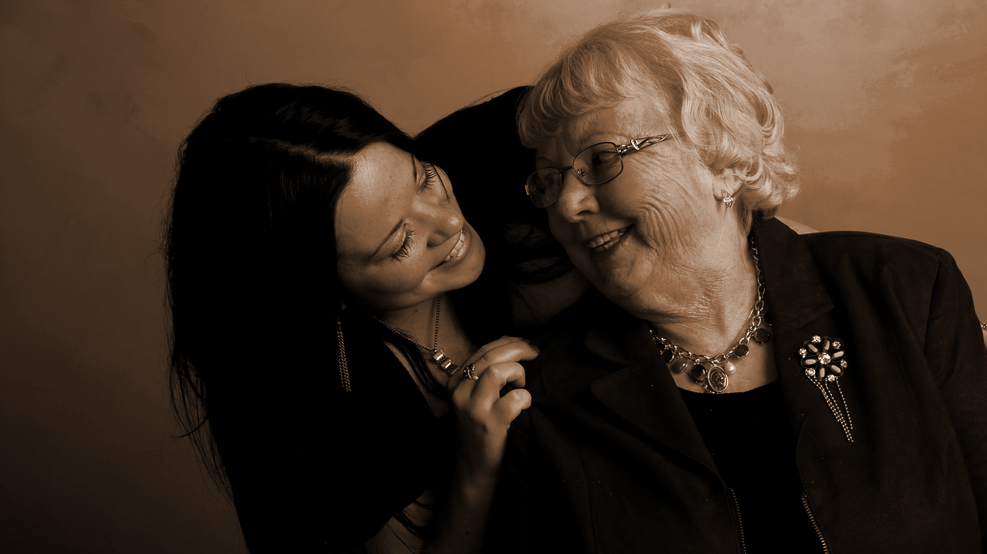
What our partners are saying
“Many older adults in our neighborhoods have found themselves with space in their homes and a need for companionship. Our partner, Nesterly, provides options for people.”
~ Mayor Marty Walsh, Boston
Nesterly.com Partner Presentation

Slide 9
Thank you.
Noelle Marcus, CEO
noelle@nesterly.com
Nesterly.com Partner Presentation

